Slide 1
Notes:
add speaking notes here. They will only be visible by presenters and not by viewers

Slide 2
OYAP Programs @ SLC
Automotive Service Technician (Cornwall) – 8 weeks fall semester
Brick & Stone (Kingston) – 8 weeks winter semester
Cook (Kingston) – Fall &Winter semesters
General Carpentry (Cornwall & Kingston) – 8 weeks fall semester
Hairstylist (Kingston) – Fall & winter semester (Mondays)
Millwright (Kingston) – Fall & winter semester (Tuesdays)
Plumbing (Kingston) – 8 weeks fall semester
Welding (Cornwall) – 10 weeks fall semester
Notes:
add speaking notes here. They will only be visible by presenters and not by viewers

Slide 3
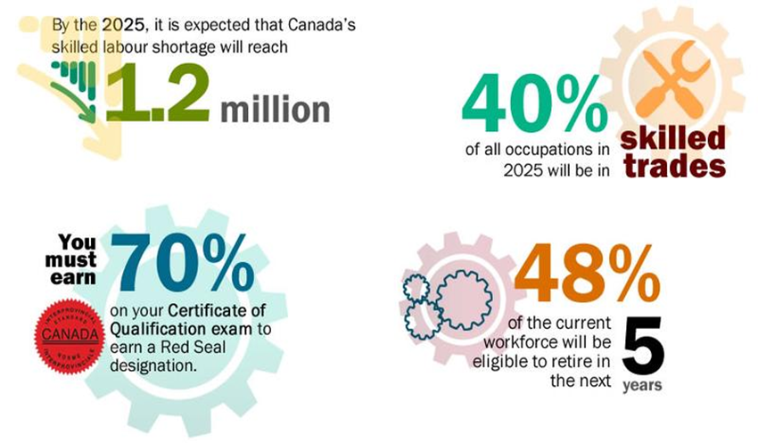
HELLO FUTURE
Notes:
add speaking notes here. They will only be visible by presenters and not by viewers

Slide 4
As an apprentice...
All students must have a Registered Training Agreement with the Ministry of Training, Colleges and Universities
MTCU
College (SLC)
High school
Work / Co-op
You are now registered at SLC and have a student number
Notes:
add speaking notes here. They will only be visible by presenters and not by viewers

Slide 5
HELLO FUTURE
Notes:
add speaking notes here. They will only be visible by presenters and not by viewers

Slide 6
Benefits of OYAP
•Specialized and general transferable, employability skills
•A network for future employment (gets your foot in the door of a potential employer/trainer to prove yourself)
•Smoother school-to-work transition by getting you started into the skilled trades at an earlier age
•OYAP students are trained in a specific set of skills and will obtain apprenticeship hours, new skills and high school credits at the same time reducing post-secondary qualification time
•The knowledge and talent of the partners involved in OYAP creates the best possible learning in state-of-the-art training environments for apprentices
•In-class training: $400-$600 per level. Most trades require 3 levels of in-class training (Diploma programs cost approx. $3,230 per year)
Notes:
add speaking notes here. They will only be visible by presenters and not by viewers

Slide 7
Course Materials
Please ensure that you have all your necessary course materials. Contact the Dual Credit Office on your campus if you need your course materials. Examples of materials include:
Cooks
Uniform (Phase 2) & black non-slip shoes (you provide)
Hairstylists
Head manikins & kit (Provided by PASS)
Black clothes (you provide)
Other OYAP Programs:
Long hair must be tied back and pants must be worn in class
Safety boots: green triangle, steel toe (submit complete receipts with tax breakdown
to PASS office. Support is based on available funding)
Essentials and textbooks for each trade provided for the term
Notes:
add speaking notes here. They will only be visible by presenters and not by viewers

Slide 8
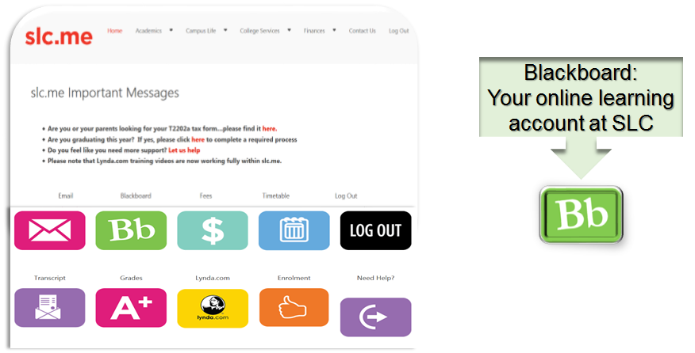
SLC.ME
Notes:
add speaking notes here. They will only be visible by presenters and not by viewers

Slide 9
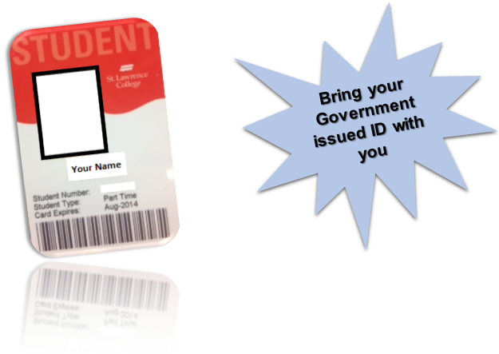
STUDENT CARD
Kingston - located on second level in Student Association
Brockville - Student Services
Cornwall – Student Services
Notes:
add speaking notes here. They will only be visible by presenters and not by viewers

Slide 10
SNOW DAYS & P.A. DAYS
P.A. Days: You must attend your Level 1 Apprenticeship
Snow Days: The college rarely closes for snow days
Please contact your college instructor and Dual Credit teacher
Notes:
add speaking notes here. They will only be visible by presenters and not by viewers

Slide 11
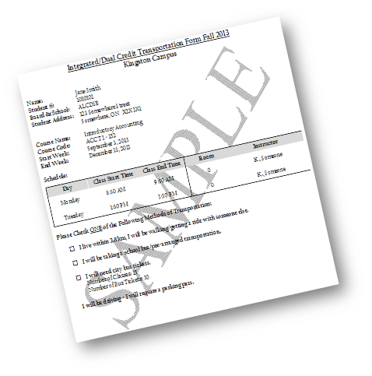
TRANSPORTATION
We will not pay for parking tickets!
Notes:
add speaking notes here. They will only be visible by presenters and not by viewers

Slide 12
Parking
You must register your vehicle/motorcycle with St. Lawrence College prior to your first day of class
To register please fill out your transportation form or email Jenn Halligan jhalligan@sl.on.ca with the following information:
License Plate Number
Make of vehicle
Only valid from your semester start and end date, and on the day(s) you attend the College.
Notes:
add speaking notes here. They will only be visible by presenters and not by viewers

Slide 13
ASSESSMENT AT COLLEGE
You must pass all of your St. Lawrence College courses in order to receive your Level 1 Apprenticeship
A grade of 50% or higher must be obtained
You are now a college student and you will be evaluated as one
There are deadlines - marks can be taken off or zeros can be given
You must attend class and do the work in order to be successful
Notes:
add speaking notes here. They will only be visible by presenters and not by viewers

Slide 14
COMPLETING YOUR LEVEL 1 APPRENTICESHIP:
Highschool Transcript (OSSD)
If you pass all your courses, you will receive two or three high school credits.
College Transcript
All your course grades will appear on your SLC transcript.
Ministry of Training, Colleges and Universities:
A pass or fail designation for each student will be sent to the MTCU office.
No marks are submitted.
Notes:
add speaking notes here. They will only be visible by presenters and not by viewers

Slide 15
WHAT DO I DO AFTER JUNE 30TH?
Take a copy of your completed education requirement (i.e. completed OSSD) to the local MTCU Apprenticeship Office
Secure employment with a contractor (wage is usually 40% of what a licensed skilled worker would earn)
Ensure you have your employer sign your Apprenticeship Training Standard on a regular basis
If you change employers let the MTCU Apprenticeship office know about the change. Note: Take your Training Standard with you
Apply to graduate through your SLC.me and you will receive a certificate in the mail from St. Lawrence College for your Level 1 completion
After you graduate from high school you must direct your questions to your local MTCU Apprenticeship Office (e.g. Level 2 program)
Notes:
add speaking notes here. They will only be visible by presenters and not by viewers

Slide 16
Questions?
Notes:
add speaking notes here. They will only be visible by presenters and not by viewers

